Slide 1
Quadrisection-Based Task Mapping on Many-Core Processors for Energy-Efficient On-Chip Communication
Nithin Michael, Yao Wang, G. Edward Suh and Ao Tang
Cornell University
N. Michael, Y. Wang, G. E. Suh & A. Tang | Quadrisection-Based Task Mapping
Notes:
Thank you for the introduction. Good afternoon everyone. In this talk, I’m going to talk about a task mapping algorithm called Quadrisection which targets for energy-efficient on-chip communication. This is joint work with Nithin Michael, Professor Edward Suh and Professor Kevin Tang at Cornell University

Slide 2
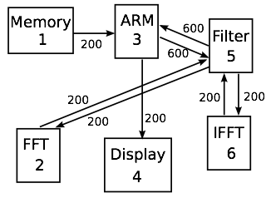
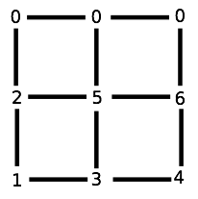
Task Mapping Problem
~Introduction~ | Problem Formulation | Quadrisection | Evaluation | Conclusions
Task mapping for many-core processor
Our focus – mapping communicating application tasks to cores to minimize communication power consumption
DSP
N. Michael, Y. Wang, G. E. Suh & A. Tang | Quadrisection-Based Task Mapping
Notes:
With technology scaling, more and more cores are integrated into a single chip. This creates a challenge for resource management and utilization. Task mapping is one of the problems. We define task mapping problem as follows. Given a set of tasks and communication requirement between them, we map the tasks to a many-core processor to achieve some certain goal. Here is one possible mapping to a many-core processor with mesh network. It’s obvious that different mappings will result in different performance and power consumption. And our goal in this work, is to find the mapping that can minimize the communication power consumption.

Slide 3
Assumptions
Introduction | ~Problem Formulation~ | Quadrisection | Evaluation | Conclusions
Applications of interest consist of multiple tasks communicating via message passing, represented by communication task graph (CTG)
Number of tasks are less than number of cores
Assume mesh network and dimension-ordered routing
CTG for DSP
N. Michael, Y. Wang, G. E. Suh & A. Tang | Quadrisection-Based Task Mapping
Notes:
We made several basic assumptions. Firstly, the application consists of multiple tasks and communicate via message passing. The application is represented by a communication task graph, or CTG for short, which describes the set of tasks and the communication rate between them, as you can see in this DSP example. Secondly, we assume the number of tasks to be mapped are less than the number of cores because we are interested in mapping, not scheduling multiple tasks on a single core. Besides, we also assume a mesh network and dimension-ordered routing.

Slide 4
Problem Difficulty
Introduction | ~Problem Formulation~ | Quadrisection | Evaluation | Conclusions
A(i, j), communication rate from task i to task j
B(i, j), Manhattan-distance between node i and node j of the NoC
p(i), p(j), nodes to which task i and task j are mapped
Represent the dynamic power consumption
Task mapping is exactly the Quadratic Assignment Problem
NP-Hard
Difficult to approximate
N. Michael, Y. Wang, G. E. Suh & A. Tang | Quadrisection-Based Task Mapping
Notes:
And here is how we formulate the problem mathematically. A(i, j) denotes the communication rate from task i to task j, and B(i, j) is the Manhattan-distance between node i and node j. Since we are using dimension-order routing, so B(i, j) is also the number of hops for communication flow between node i and node j. The cost function is defined as the sum of A(i, j) times B(p(i), p(j)), in which p(i) and p(j) means the nodes that task i and task j are mapped to. Basically, this means we multiply the communication rate between two tasks and the number of hops between where they are mapped. Intuitively, this can represent the communication power consumption, so the lower, the better. And our goal is find the mapping function p() that can minimize this cost. However, this is exactly the Quadratic assignment problem and it’s NP-Hard.

Slide 5
State of the Art
Introduction | ~Problem Formulation~ | Quadrisection | Evaluation | Conclusions
NMAP – Initial greedy map followed by pair wise swaps
Computation intensive, slow
BMAP – Clustering based approach merging communicating tasks
Poor quality (High cost value)
Bisection – Recursively divide the task graph into equal halves to minimize the communication between them
[1]
[1] K. Srinivasan and K. S. Chatha. A Technique for Low Energy Mapping and Routing in Network-on-Chip Architectures. ISLPED 2005
N. Michael, Y. Wang, G. E. Suh & A. Tang | Quadrisection-Based Task Mapping
Notes:
There have been several existing approaches dealing with this task mapping problem. NMAP uses a initial greedy map and then does pair wise swaps to improve the mapping. The quality of the resulted mapping is fair but the algorithm is quite slow. Another approach BMAP tries to cluster communicating tasks together step by step, but the quality of resulted mapping is quite poor. Bisection approaches this problem by recursively dividing the task graph into halves and trying to minimize the communication between these halves. The operations are shown in this figure. Firstly, it divides the task graph into the left and right panel. Then for each subpanel, it further divides into a top and bottom panel. This is repeated until the size of a subpanel equals to a single node. Bisection achieves mapping with quite good quality and it’s much more efficient than NMAP.

Slide 6
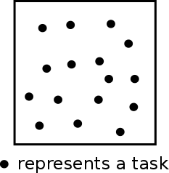
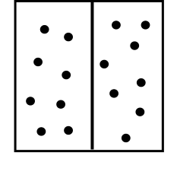
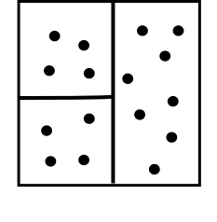
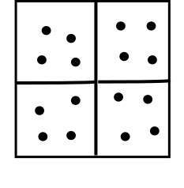
Can we improve Bisection?
Introduction | Problem Formulation | ~Quadrisection~ | Evaluation | Conclusions
Key observation: Mapping is a 2D problem
Bisection uses vertical and horizontal min-cut based on Fiduccia-Mattheyses (FM) algorithm
FM is applied to 1D, the derived local optimum doesn’t consider the 2D mapping
FM
FM
FM
N. Michael, Y. Wang, G. E. Suh & A. Tang | Quadrisection-Based Task Mapping
Notes:
So, can we do better than Bisection? Our key observation is that mapping is a 2-dimension problem. Bisection approaches this 2D problem by using vertical and horizontal cut of a task graph. The cutting is based on Fiduccia-Mattheyses algorithm, or FM for short. Understand FM is very important, so I’m going to spend a little time explaining how FM works. Assume we have a communication task graph, the FM divides it into a left and right panel. The FM first divides the task graph randomly. Then it swaps one node between left and right panel that can reduce the communication cost between the two panels. This swap operation is repeated until no swap can further reduce the communication between two panels, which means the mapping has arrived at a local optimum. The next step is applying FM algorithm to each of the subpanels, and we do this recursively until the task graph is fully mapped. What’s the potential limitation here? As we can see, in each step, FM algorithm is only applied to 1D by dividing a panel into two subpanels, so the derived local optimum does not consider the 2D property of task mapping problem.

Slide 7
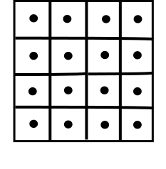
Quadrisection
Introduction | Problem Formulation | ~Quadrisection~ | Evaluation | Conclusions
Main idea: apply FM algorithm to 2D mapping
Explore a different part of design space
The local optimal considers 2D mapping
Further optimize subpanel placement by brute force search
1 hop
FM
FM
2 hops
N. Michael, Y. Wang, G. E. Suh & A. Tang | Quadrisection-Based Task Mapping
Notes:
Based on the previous observation, we came up with Quadrisection. The main idea is applying FM algorithm to 2D mapping. Again, assume we have a task graph, in Quadrisection, the graph is divided into 4 panels using FM algorithm. The FM works very similar to that in Bisection, it swaps one node between 2 panels out of the 4 to reduce the total communication cost among the 4 panels. and this swap operation is repeated until no swap can further reduce the communication cost. The main difference is how we calculate the communication cost. In Quadrisection, communication across the diagonal are counted as 2 hops, so the communication cost between diagonal panels will time a weight 2 while communication cost between neighboring panels only have a weight 1. This calculation of communication cost exactly captures the 2D property of the task mapping problem, and we believe this heuristic will explore the design space better than the bisection algorithm. Furthermore, we optimize the subpanel placement by brute force search. For example, in the top left panel, we permutate the position of four subpanels to find out the best placement that minimize the communication cost to the other 3 panels.

Slide 8
Evaluation Methodology
Introduction | Problem Formulation | Quadrisection | ~Evaluation~ | Conclusions
Evaluations were performed numerically and using simulation
Performance was evaluated for mesh networks for
Synthetically generated random task graphs
Multimedia benchmarks
Simulations were performed using cycle level simulator and power consumption were evaluated using Orion2
N. Michael, Y. Wang, G. E. Suh & A. Tang | Quadrisection-Based Task Mapping
Notes:
We evaluate the effectiveness of Quadrisection using both numerical result and simulation. For numerical result, we evaluate the cost function of mappings derived from different algorithms. The benchmarks we use include both synthetic task graphs and multimedia benchmarks. For simulation, we use a cycle level network simulator to simulate the network traffic based on the task mapping and derived the power using Orion2.

Slide 9
Cost: Synthetic Task Graph
Introduction | Problem Formulation | Quadrisection | ~Evaluation~ | Conclusions
100 randomly generated CTGs were mapped to 4-by-4 mesh network
N. Michael, Y. Wang, G. E. Suh & A. Tang | Quadrisection-Based Task Mapping
Notes:
Here is the numerical result for synthetic task graphs. We randomly generated 100 task graphs which are mapped to 4-by-4 mesh network using 4 different algorithms. The figure shows the average cost of each algorithm normalized to Quadrisection. As a reminder, the cost is the lower, the better. As can be seen, Quadrisection outperforms NMAP and BMAP by 20-30 percent, and outperforms Bisection by about 7%.

Slide 10
Power: Multimedia Benchmarks
Introduction | Problem Formulation | Quadrisection | ~Evaluation~ | Conclusions
Communication Power
N. Michael, Y. Wang, G. E. Suh & A. Tang | Quadrisection-Based Task Mapping
Notes:
Next is the result for communication power consumption of multimedia benchmarks. We collected the network traffic using a cycle-level network simulator and then derive the power consumption using Orion2 power models. Because some task graphs are small enough, we are able to derive the optimal mapping. So the optimal mapping provides a reference of how well our algorithm can achieve. Qudrisection achieves about 7% less power consumption compared with Bisection, and achieves 10%-20% less power consumption than NMAP and BMAP. On average, it’s within 2% of the optimal mapping.

Slide 11
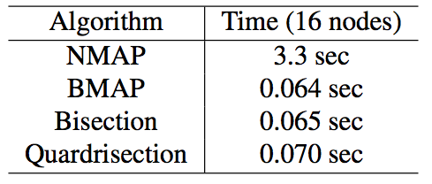
Execution Time
Introduction | Problem Formulation | Quadrisection | ~Evaluation~ | Conclusions
Quadrisection’s runtime is comparable with previous approaches
N. Michael, Y. Wang, G. E. Suh & A. Tang | Quadrisection-Based Task Mapping
Notes:
Runtime of an algorithm is also an important metric to deal with this NP hard problem. Quadrisection has similar runtime with BMAP and Bisection, and is orders of magnitude faster than NMAP algorithm.

Slide 12
Conclusions
Introduction | Problem Formulation | Quadrisection | Evaluation | ~Conclusions~
Quadrisection outperforms commonly used mapping approaches by exploiting 2D structure
Run-time of Quadrisection is comparable to the state-of-art
Useful addition to NoC designer’s toolkit.
N. Michael, Y. Wang, G. E. Suh & A. Tang | Quadrisection-Based Task Mapping

Slide 13
Cost: Multimedia Benchmarks
Introduction | Problem Formulation | Quadrisection | ~Evaluation~ | Conclusions
Cost
N. Michael, Y. Wang, G. E. Suh & A. Tang | Quadrisection-Based Task Mapping
Notes:
Next is the result for multimedia benchmarks. Because some task graphs are small enough, we are able to derive the optimal mapping. So the optimal mapping provides a reference of how well our algorithm can achieve. As can be seen, Quadrisection performs well in most cases. On average, it’s within 2% of the optimal mapping and performs best out of the 4 algorithms.

