Slide 1
Efficient Timing Channel Protection for On-Chip Networks
Yao Wang and G. Edward Suh
Cornell University

Slide 2
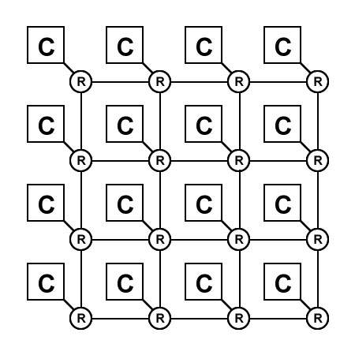
On-Chip Networks are Shared Resources
Future large-scale multi-cores will be shared among multiple applications / virtual machines
Virtual Machine A
Virtual Machine B
Notes:
Figures – Processor picutres / Mesh NoC / cloud computing – virtual machines
To fully utilize the many-core system, parallel workloads are running concurrently
They share resources such as caches ($L2), On-chip network, memory controller, etc
The on-chip network is shared by different applications to deliver traffic, which causes interference between each other
Cloud computing

Slide 3
Problem: Timing Channels
Shared NoC causes interference
Virtual Machine A
Network interference introduces timing channels
Side channel
Covert channel
High assurance systems requires security guarantee
Example: Corporate virtual machines on the cloud
Virtual Machine B
Notes:
The latency and throughput variations from network interference form timing channels which can be utilized to extract information.
These are often called side channel or covert channel attacks. These attacks can result in the leakage of critical information
Why is this an important problem
Point out examples: high assurance (corcoporate VMs, military, flight control? …
In high assurance systems, these timing channels should be eliminated to provide security guarantee.
Cloud computing running multiple virtual machines on the same hardware (trade secret, customer profiles, etc)

Slide 4
RSA Example
RSA : a public key cryptographic algorithm
Prone to timing channel attacks
key: 0110…
RSA
Attacker
Core 0
Core 1
Core 2
MC 0
MC 1
MC 2
Crossbar

Slide 5
RSA Example
RSA : a public key cryptographic algorithm
Prone to timing channel attacks

Slide 6
Outline
Objective: Eliminate timing channels through the shared on-chip networks
Completely eliminate information leakage
Low performance overhead
Rest of the talk
Potential approaches
Our solution
Evaluation
Related work
Conclusion

Slide 7
Use Quality-of-Service?
QoS techniques provide performance isolation to different network flows
QoS techniques are not enough for security
A flow can use bandwidth beyond its allocation
Bandwidth utilization reveals the flow demand
1
2
Flow A Demand | Flow B Demand | Flow A BW utilization
100% | 100%
100% | 0%
B
A
Bandwidth allocation
A: 50%
B: 50%
50%
100%

Slide 8
Static Partitioning
To eliminate timing channels, resource allocation cannot depend on run-time demands
Static partitioning
Spatial Network Partitioning (SNP)
Temporal Network Partitioning (TNP)
Completely eliminate the timing channels
High performance overhead
VM A
VM A
Cycle 0
Cycle 1
…
VM B
VM B
SNP
TNP

Slide 9
One-Way Information Leak Protection
Usually only one-way information protection is needed
Multi-level security (MLS) model
One-way protection is the key for efficient timing channel protection
Business App
(Bank Management)
Corporate VM
High-Security Domain
Information
flow
Personal APP
(Music Player)
Regular VM
Low-Security Domain
PC
Cloud Computing
In general
Notes:
Figure (multiple levels of security, which information flows are allowed and which are not)
Multi-level security model (MLS), security domains
Usually only one-way information protection is needed, from high-security domain to low-security domain
This property is crucial to provide efficient timing channel protection

Slide 10
Timing Channel through NoC
1
HS: High-Security Domain
LS: Low-Security Domain
HS ---> LS
LS throughput
0
1
HS demand
Notes:
Dependency curve
HS → LS
Performance of LS domain changes w/ demands from HS
LS doman’s communication latency / throughput should not be impacted by HS domain communications

Slide 11
Reversed Priority with Static Limits (RPSL)
Reversed Priority
Assign high priority to low-security domain
The behavior (throughput, latency) of low-security domain is not affected by high-security domain
Static Limits
Low-security domain could initialize Denial-of-Service (DoS) attack
Static limit controls the amount of traffic that low-security domain can send during a certain interval
Notes:
Firetruck example
Basic idea: assign high priority to low-security traffic so that its behavior is not affected by the dynamic variation of the high-security traffic

Slide 12
Implementation: Avoid Interference
Priority-based separable allocator
Input arbiter & Output arbiter
Static virtual channel allocation
Avoid head-of-line blocking
Router
Low-security Domain
Virtual Channels
Input link
0
High-security Domain
1
2
3

Slide 13
Implementation: Avoid DoS
Static limit control mechanism
Counter & Control logic
Apply to both input and output arbiter
Priority-based Arbiter
Low-security Domain
Winning
Request
Requests
High-security Domain
Static limit Control
Counter
Input Arbiter

Slide 14
Benefits of One-Way Protection
HS
1
2
LS
Round-robin Allocator
HS
HS
BW
Utilization
Total BW
LS
LS
Temporal Network Partitioning
HS
Time
HS
Total BW
BW
Utilization
LS
LS
RPSL
HS
Time
HS
Total BW
BW
Utilization
LS
LS
Time

Slide 15
Experimental Setup
Goals of experiments
Timing channel protection
DoS protection
Performance overhead
Darsim: cycle-level NoC simulator
Comparison of three schemes
Round-robin allocator (ISLIP)
Temporal Network Partitioning (TNP)
Reversed Priority with Static Limits (RPSL)

Slide 16
Timing Channel: No Protection
Simple network
Round-robin allocator
HS
1
2
3
4
Low-security Domain
LS
High-security Domain
Notes:
Simple example using TNP and RPSL (Figure)
Prove the effectiveness of both schemes

Slide 17
Timing Channel: Two-way Protection
Simple network
Temporal Network Partitioning
HS
1
2
3
4
Low-security Domain
LS
High-security Domain
0.4/1.0
Notes:
Simple example using TNP and RPSL (Figure)
Prove the effectiveness of both schemes

Slide 18
Timing Channel: One-way Protection
Simple network
Reversed Priority with Static Limits (Static limit = 0.8)
HS
1
2
3
4
Low-security Domain
LS
High-security Domain
1.0/1.0
Notes:
Simple example using TNP and RPSL (Figure)
Prove the effectiveness of both schemes

Slide 19
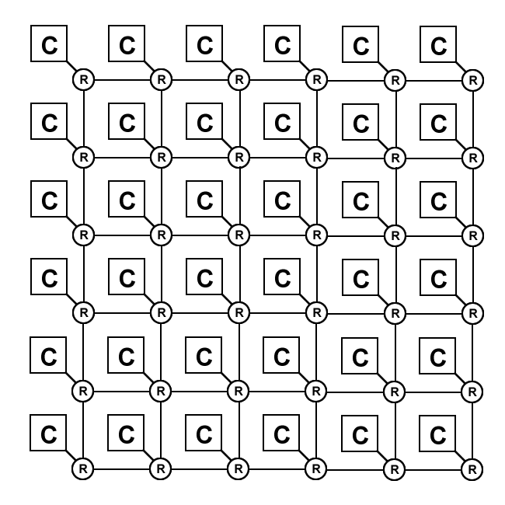
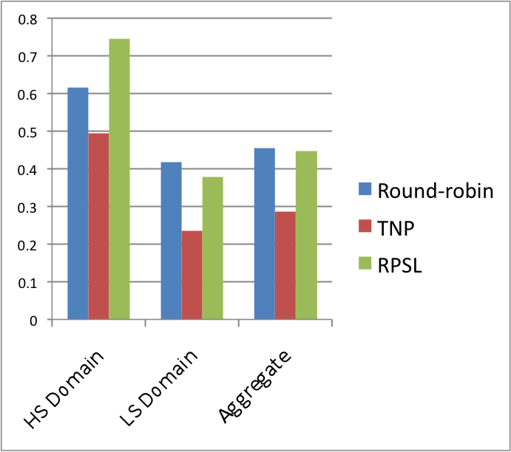
Performance
HIGH
Applications show bursty traffic
RPSL is efficient for bursty traffic
LOW

Slide 20
Related Work
Side-channel protection
Shared resources are prone to side-channel attacks, e.g. shared caches, branch prediction
Cannot be applied to NoC
QoS schemes
Allows resource usage beyond allocation
Insufficient to prevent timing channel attacks
Composability
Remove interference between applications for fast integration
Require bi-directional non-interference, incur high performance overhead

Slide 21
Conclusion
Shared on-chip networks introduce timing channels
Prevent effective sharing of large-scale NoC in high assurance systems
One-way timing channel protection is sufficient in many situations
RPSL provides efficient one-way timing channel protection
Incurs low performance overhead

Slide 22
Extend to Multiple Domains

Slide 23
Denial-of-Service Protection (RPSL)
Simple network
HS
1
2
3
4
Low-security Domain
LS
High-security Domain
Static Limit on LS
Static Limit on LS

Slide 24
Synthetic Traffic Patterns
HIGH
6-by-6 mesh network
Two security domains
Transpose traffic
LOW
LS offered BW
LS offered BW
LS offered BW
Round-robin
Temporal Network Partitioning
RPSL

Slide 25
Synthetic Traffic Patterns
HIGH
6-by-6 mesh network
Two security domains
Hotspot Traffic
LOW
Round-robin
Temporal Network Partitioning
RPSL

