Slide 1
Performance Evaluation of On-Chip Sensor Network in MPSoC
Yao Wang, Yu Wang, Jiang Xu, Huazhong Yang
EE. Dept, TNList, Tsinghua University, Beijing, China
Computing System Lab, Dept. of ECE
Hong Kong University of Science and Technology, Hong Kong, China

Slide 2
Outline
Motivation
An Overview of SENoC
Experiments
Future work
Q&A

Slide 3
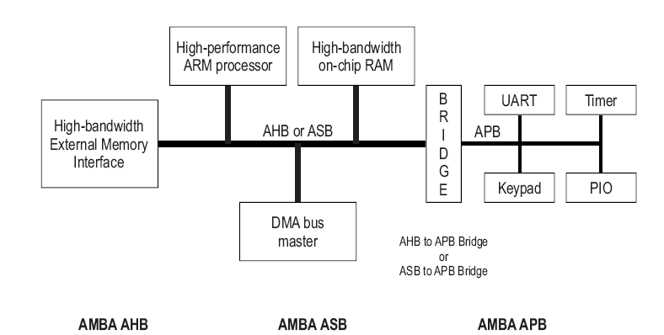
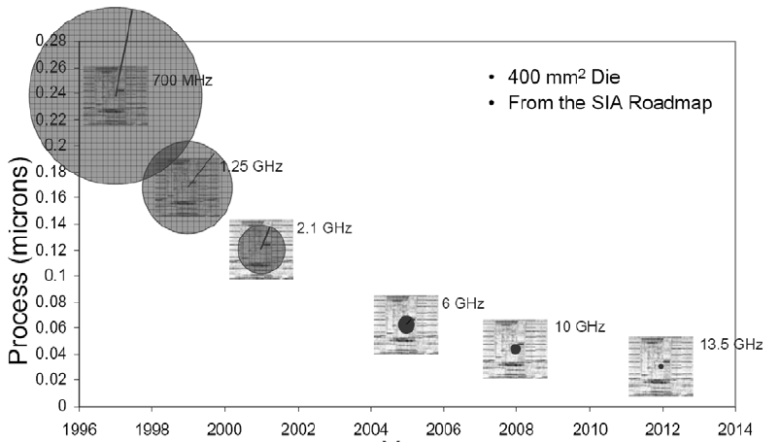
Limitations of Bus Interconnect
In the past, the on-chip interconnects are mainly share-medium buses
Disadvantages:
Bus architecture mainly uses global synchronized circuits, which is harder to realize with the ever increasing frequency because of “clock skew”
The performance of bus interconnect is not scalable with the number of cores. For future MPSoC which will integrate hundreds of cores on a single chip, bus interconnect is no longer suitable
ARM AMBA Specification and Multi layer AHB Specification (rev2.0), http://www.arm.com, 2001
“Architectural innovations for network on chip”, Vijaykrisnan Narayanan, Pennsylvania State University

Slide 4
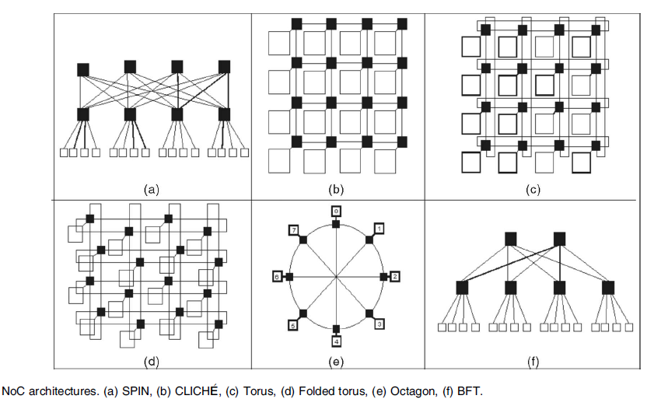
Network-on-Chip (NoC)
To address the disadvantages of bus architec-ture, NoC is proposed to be a solution
Advantages:
Avoid the “clock skew” problem by GALS circuits
Solve the performance bottleneck by supporting multiple-to-multiple communication pattern
Shorten the design time by supporting IP reuse
Various topologies to fit different applications
Partha Pratim Pande, etc. “Performance Evaluation and Design Trade-offs for Network-on-Chip Interconnect Architectures”, IEEE Transactions on Computers

Slide 5
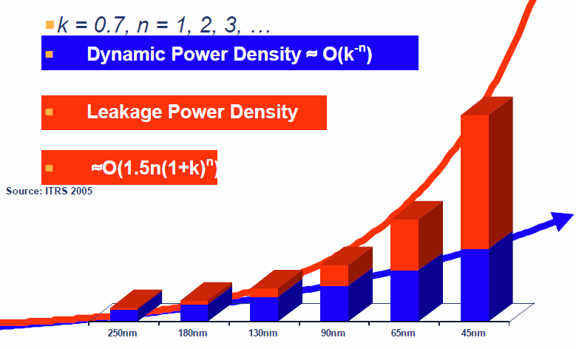
Sensor Network-on-Chip (SENoC)
Why sensors are employed in MPSoC design?
More PUs are integrated in MPSoC
Intel predicts that within ten years processors might have tens or even thousands of cores
2. Reducing feature size brings higher variations
180nm->130nm->90nm->65nm->45nm
3. Scaling technology introduces higher power density which raises thermal problem
For reliability and performance optimization concern, we need to introduce sensors into NoC.

Slide 6
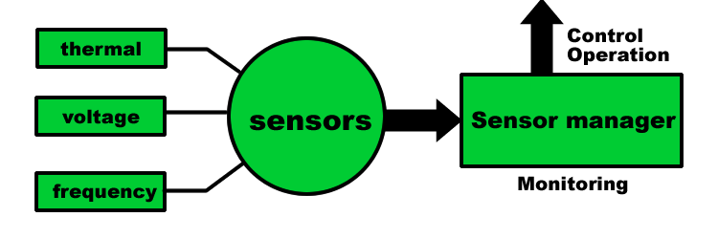
Working Flow of SENoC
Sensor collect information (Temperature\ Voltage\ frequency)
Sensor information is sent to a processing unit through NoC
The processing unit analyze the information and then make decision
The decision is sent to a related core through NoC
The related core receives the decision and takes action

Slide 7
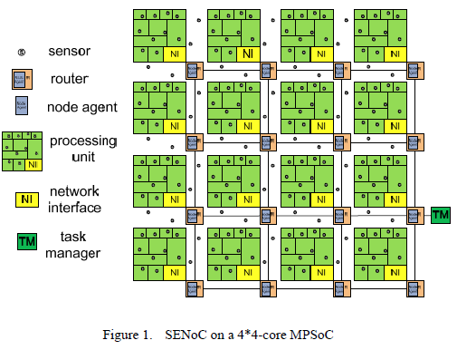
Related Work I
Combine NoC and sensors to perform system monitoring and control.
Yu Wang et al. proposed a systematic app-roach, on-chip sensor network (SENoC), to collaboratively detect, report, and alleviate run-time threats (e.g. simultaneous switch-ing noise) in MPSoC
Avoid the traditional stop-go method, obtain a 26.12% performance gain
Yu Wang, Jiang Xu, Shengxi Huang, Weichen Liu, HUazhong Yang, “A Case Study of On-Chip Sensor Network in Multiprocessor System-on-chip,” in CASES 2009

Slide 8
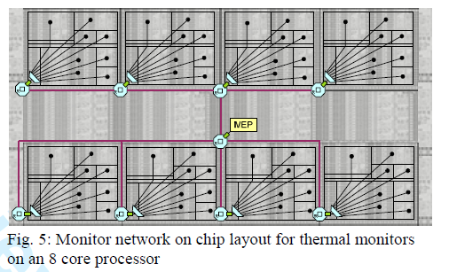
Related Work II
Build a sub-network to transfer only sensor info. Mudduri et al proposed a monitor subsystem called “MNOC”
advantage: sensor info will not interfere with the regular traffic
disadvantage: extra area and higher design complexity, not scalable
S. Madduri, R. Vadlamani, W. Burleson, R. Tessier, “A Monitor Interconnect and Support subsystem for Multicore Processors,” in the Proceedings of the IEEE/ACM Design Antomation and Test in Europe Conference, Nice, France, April 2009.

Slide 9
Evaluation of SENoC
While sensors provide great benefit for system reliability and performance optimization, the sensor information will occupy the bandwidth resources.
To evaluate the overhead of performance loss after adding sensors, our paper develop a SENoC simulation platform.
Bandwidth
Regular data
Sensor data

Slide 10
Main Contributions of The Paper
We developed a SENoC simulation platform in systemC which supports cycle-accurate simulation
We study the average delay of regular data and sensor data, respectively. The results show that the overhead of sensors is negligible , with a max delay overhead of 0.80% when the traffic is not that heavy
We explore the influence of the sensor manger’s location on the network performance

Slide 11
Outline
Motivation
An Overview of SENoC
Experiments
Future work
Q&A

Slide 12
NoC Architecture
4*4 Mesh-like NoC

Slide 13
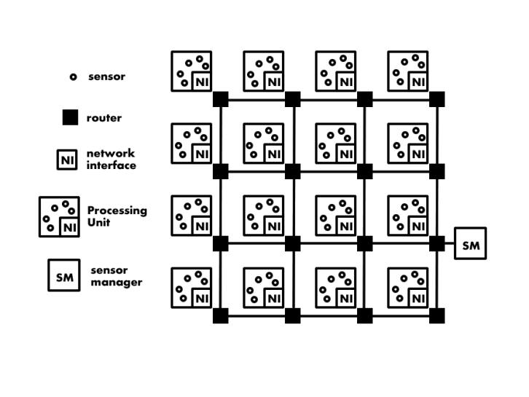
SENoC Architecture
After adding sensors and sensor manager, the NoC becomes SENoC

Slide 14
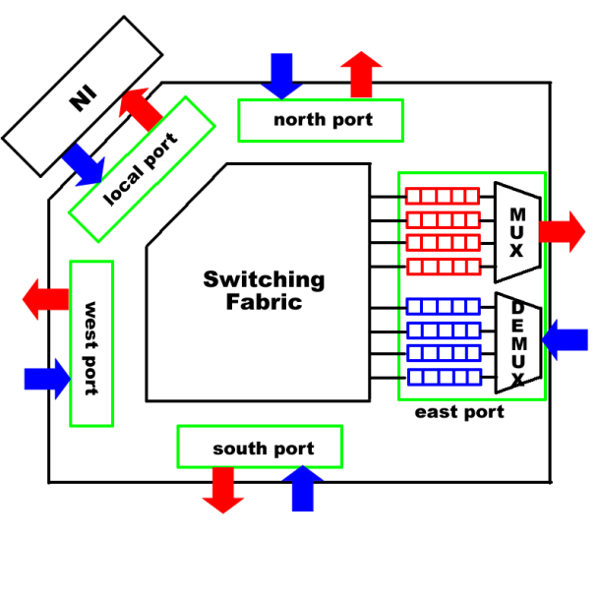
Router Architecture
The router routes the flit according to the routing table

Slide 15
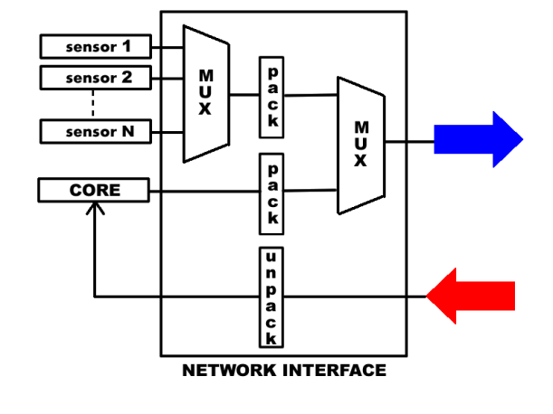
Network Interface
Network interface multiplex the sensor data and regular data

Slide 16
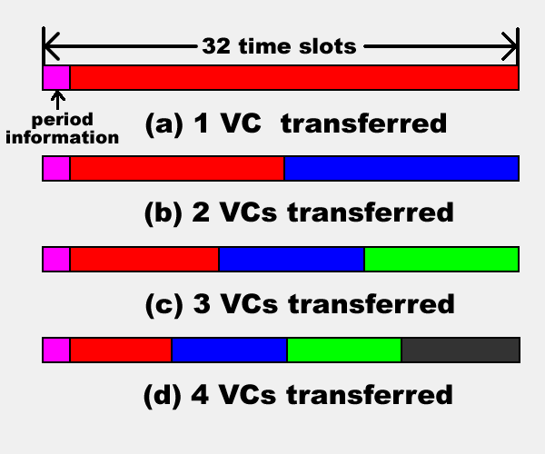
Switching Methodology
4 Virtual Channel, X-Y static routing
Time is divided into frames, with 32 time slots forming a frame.
Traditional VC method
In each frame, there are 4 transfer modes according to the status of the output buffers

Slide 17
Switching Methodology
Empty
Non-empty
Empty
Non-empty

Slide 18
Outline
Motivation
An Overview of SENoC
Experiments
Future work
Q&A

Slide 19
Simulation Setup
Flit size: 32
Operating frequency: 1GHz
Data Distribution: Poisson distribution (λ=0.2)
Buffer Size: 10
Sensors: 8/per core (For DVS application)
Masters: 8 (uniform data flow)
Slaves: 8

Slide 20
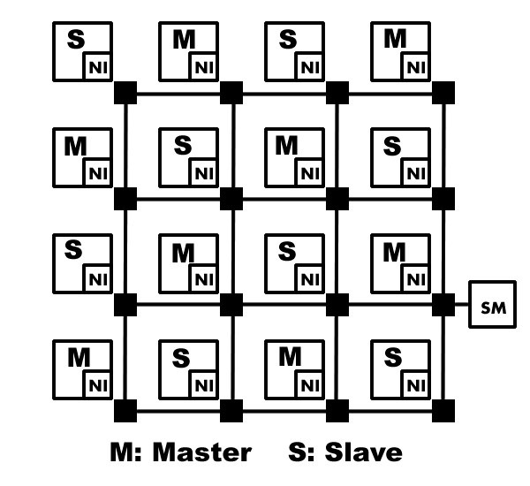
Distribution of Masters & Slaves

Slide 21
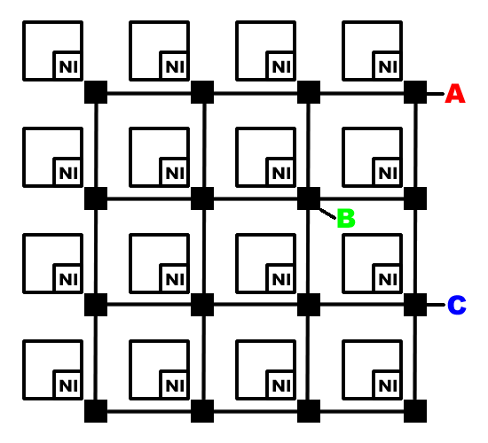
Experiments
Variable Parameters
1. The location of sensor manager
2. The interval of two sensor data sampling
(200, 500, 1000, 2000 cycles. Typically 3000)
Performance metric
Average latency of sensor data and regular data, respectively.

Slide 22
Experiments
Results
Location | A (corner) |  | B (center) |  | C (edge)
Cycles Between Two samples | Average Delay of Regular data | Average Delay of Sensor data | Average Delay of Regular data | Average Delay of Sensor data | Average Delay of Regular data | Average Delay of Sensor data
∞ | 98.86 | N/A | 98.86 | N/A | 98.86 | N/A
200 | 99.65 | 130.80 | 98.79 | 104.87 | 99.19 | 113.64
500 | 98.98 | 120.24 | 99.32 | 105.48 | 98.47 | 106.78
1000 | 99.10 | 109.03 | 98.80 | 97.23 | 98.91 | 98.73
2000 | 98.99 | 101.83 | 98.87 | 98.03 | 98.89 | 93.70
Conclusion 1: After adding sensor data, the average delay of regular data has no big change (maximum 0.80%)
Conclusion 2: The delay of the sensor data increases with the sampling rates.
Conclusion 3: Under the uniform data flow, it’s best to place the sensor manager in the center.

Slide 23
Outline
Motivation
An Overview of SENoC
Experiments
Future work
Q&A

Slide 24
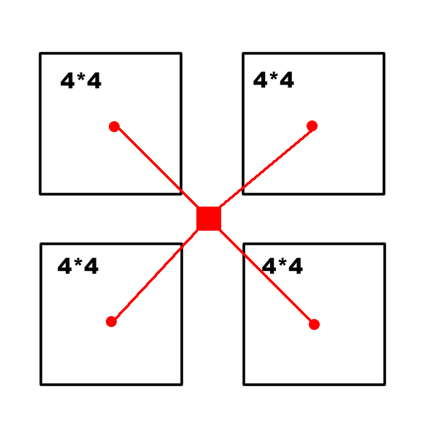
Future work
1. Scalability of SENoC
When the number of cores rises to 64 or 256 or even more, will our strategy be applicable?
Consider following idea:
2. Placement of sensor manager
Hardware: application-aware design, a design methodology to place the SM according to the communication pattern
Software: Dynamically locate the SM at a place where the traffic is not heavy to alleviate contention

Slide 25
Outline
Motivation
An Overview of SENoC
Experiments
Future work
Q&A

