Slide 1


Secure Dynamic Memory Scheduling against
Timing Channel Attacks
Yao Wang, Benjamin Wu, G. Edward Suh
Cornell University

Slide 2


Timing Channel Problem
What is a timing channel?
Why do we care?
  Attacks demonstrated in real world environment
    Example: cache timing channel attacks in Amazon EC2^{1,2}
  Capabilities
    Steal cryptographic keys, predict users’ passwords, track users’ browser visit history, etc.
# Example code:
if (secret)
sleep(10s)
else
sleep(5s)
Victim
Attacker
affects
Secret
Timing
infers
[1] Thomas Ristenpart, Eran Tromer, Hovav Shacham and Stefan Savage, “Hey, You, Get Off of My Cloud: Exploring Information Leakage in Third-Party
Compute Clouds”, CCS09
[2] Yinqian Zhang, Ari Juels, Michael Reiter and Thomas Ristenpart, “Cross-VM Side Channels and Their Use to Extract Private Keys”, CCS12

Slide 3
Timing Channels in Main Memory
Security Domain (SD)
DRAM Schedule
SD₀
SD₁
SD₁
SD₀
Memory Controller
req
req
DRAM timing constraints
Time
DRAM
Different ranks: T_{rank}
req
req
Different banks in the same rank: T_{bank}
req
req
The same bank in the same rank: T_{worst}
Banks
req
req
Rank 0
Rank 1
T_{rank} < T_{bank} < T_{worst}
6 18 43

Slide 4
A Covert Channel Attack¹
Sender sends a sequence of bits by dynamically changing memory demand
  To send a ‘0’, sender does not issue any memory request
  To send a ‘1’, sender sends many memory requests
Receiver keeps sending requests
  Measures its own throughput
  Throughput variations
Sender
Receiver
Core 1
Core 2
$L1
$L1
Memory
1 0 0 1 0 1 1 0
[1] Yao Wang, Andrew Ferraiuolo, and Edward Suh, “Timing Channel Protection for a Shared Memory Controller”, HPCA 2014.

Slide 5
Naïve Protection: Temporal Partitioning (TP)¹
Static turn scheduling
Add dead time at the end of each turn
  No new memory transactions can be issued during dead time
  T_{dead} >= T_{worst} (43 cycles)
SD₀
SD₁
SD_{N}
Time
Turn
T_{dead}
Time
Turn
Dead time introduces significant performance overhead!
[1] Yao Wang, Andrew Ferraiuolo, and Edward Suh, “Timing Channel Protection for a Shared Memory Controller”, HPCA 2014.

Slide 6
Reducing Dead Time Overhead
Spatial partitioning^{1,2}
  Map security domains to different banks or ranks
  Pro:
    Significantly reduce dead time
  Cons:
    Scalability issue
    Memory fragmentation
    Requires OS support
Bank Triple Alternation (BTA)²
  Enforce consecutive turns to access different banks
  Pro:
    Does not require spatial partitioning
  Con:
    Inefficient scheduling
T_{bank} (or T_{rank})
Bank 0,3,6
Bank 1,4,7
Bank 2,5
T_{bank}
Time
Turn
Time
Turn
[1] Yao Wang, Andrew Ferraiuolo, and Edward Suh, “Timing Channel Protection for a Shared Memory Controller”, HPCA 2014.
[2] Ali Shafiee, Akhila Gundu, Manjunath Shevgoor, Rajeev Balasubramonian and Mohit Tiwari, “Avoiding Information Leakage in the Memory Controller
with Fixed Service Policies”, MICRO 2015

Slide 7
Secure Memory Scheduling: SecMC-NI
Key idea: interleaving requests that access different ranks and banks to construct an efficient schedule
Parameter Definition
  T_{rank} : 6 cycles
  T_{bank} :18 cycles
  T_{worst}: 43 cycles
  T_{turn} : Turn length
SD₀
SD₁
SD_{N}
Time
Turn

Slide 8
Interleaving Requests that Access Different Banks
Request selection algorithm
  Requests in a turn must access different banks
  At most T_{turn}/T_{bank} requests are scheduled in each turn
  Example: T_{turn} = 54 cycles
Request reordering algorithm
  Reorder the requests so that requests that access the same bank are separated by at least T_{turn} cycles
Effect of reordering
Notes:
This is secure

Slide 9
Can We Do the Same for Ranks?
For each rank, construct the previous schedule separately
  At most T_{bank}/T_{rank} ranks are selected in each turn
Combine them by shifting each rank schedule by T_{rank} cycles
  Example: T_{turn} = 54 cycles
Rank 0
Rank 3
Rank 2
At most 9 requests can be issued in each turn !

Slide 10
Performance Evaluation
8
core
core
Simulator
  ZSim + DRAMSim2
Workloads
  Multi-program workloads using SPEC CPU2006 benchmarks
Performance metric
  Weighted speedup
32kB
$L1
$L1
$L2
8MB
Memory
1 memory channel, 8 ranks,
8 banks in each rank

Slide 11
Comparison with BTA
Weighted Speedup (Normalized to FR-FCFS)
Queuing Delay
SecMC-NI outperforms BTA by 45% on average
SecMC-NI cuts the average queuing delay of BTA by half
Notes:
We show one program with eight copies to study the impact of memory intensity
Also study mixed workloads

Slide 12
Comparison with Spatial Partitioning
SecMC-NI achieves similar performance as BP (Bank Partitioning) on average
But there is still a significant performance gap (35%) between SecMC-NI and RP (Rank Partitioning)
Can we do better?
Notes:
We show one program with eight copies to study the impact of memory intensity
Also study mixed workloads

Slide 13
Trade Security for Performance: SecMC-Bound
Key idea:
  For performance: allow dynamic memory scheduling (like FR-FCFS)
  For security: enforce each request to return at pre-determined time
Can we find the worst-case finish time for a request?
  TP with 2-core case, turn length 43 cycles
SD₀
Worst-case
finish time
Finish
R0B0
Interference from
other domains
DRAM
Time
Finish
Return
Under TP, the i th request from
security domain s can finish by
s*43 + i*43*num_domains+ 43
SD₀
req_0
SD₁
req_0
SD₀
req_1
SD₁
req_1
43
Time
Notes:
Of course we don’t want to return at TP’s time

Slide 14
Return Earlier than Worst-Case Time
SD₀
req_0
SD₁
req_0
SD₂
req_0
SD₁
req_0
What if a request
finishes after its ER?
EI
EI
EI
ER
b
b
43
43
d
Time
Return
For each request, we assign
  Expected Issue time (EI) : used for arbitration
    Parameter b: interval between EIs
    The request with the smallest EI wins the arbitration
  Expected Response time (ER) : used for security
    Parameter d: delay between EI and ER
    As long as every request returns at ER, no information leaks
      d hides the interference between different security domains

Slide 15
Limit the Information Leakage of Violations (1)
ER violation: a request finishes after its ER
  ER violations represent information leakage
Limit the information that one violation conveys
  A violation can only have one of W possible delays
Worst-case time
derived from TP
req
EI
ER
ER + d₁
ER + d_{W-1}
ER + d_{worst}
d
Time
Finish
Return
Notes:
----- Meeting Notes (9/30/16 15:28) -----
ER VIOLATION
get rid of "a kind"

Slide 16
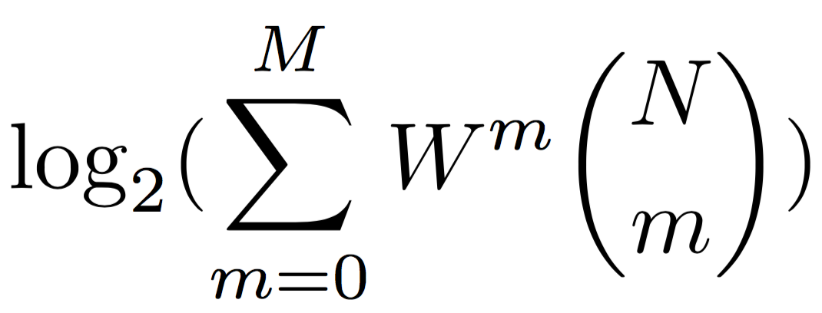
Limit the Information Leakage of Violations (2)
Set a limit on the number of violations per security domain
  M violations in every N requests (a period)
    e.g., M = 4, N = 1,000: at most 4 violations can happen in 1000 requests
  Once a security domain reaches the limit
    Always return at the worst-case time derived from TP
    Attacker cannot get further information
  Reset the violation counter after a period
How many bits can an attacker derive in a period?
This is a conservative bound !
Notes:
This is conservative bound

Slide 17
Performance under Different Limits
b = 6, d = 160
As the limit gets lower
  Performance starts to decrease due to entering worst-case mode
  Leakage decreases exponentially
Tradeoff between performance and security

Slide 18
Comparison with Previous Schemes
SecMC-Bound outperforms SecMC-NI and BP
  Trade security for performance
  The leakage is bounded

Slide 19
Summary
Shared memory controllers are prone to timing channel attacks
Previous protections suffer from either inflexibility or high performance overhead
SecMC-NI completely removes timing channels while achieving 45% performance improvement over the state of the art (BTA)
SecMC-Bound further improves the performance by enabling a trade-off between security and performance with a quantitative security guarantee

Slide 20
Backup Slides

Slide 21
Square and Multiply Algorithm for RSA
x = C
for j = 1 to n
x = mod(x², N)
if d_{j} == 1 then
x = mod(xC, N)
end if
next j
return x
Timing channel
C: encrypted message
x: decrypted message
N: product of two large prime numbers
d: RSA private key
n: the number of bits in the key

Slide 22
Optimization: Dynamic Tuning of b and d Values
Intuition: with fixed b and d values, less memory-intensive programs incur less ER violations
  Use smaller b and d values for less memory-intensive programs
  Benefit: smaller b and d values reduces memory latency
Dynamic tuning based on observed number of violations
  Assume m is number of violations in previous period (N requests)
    if m <= th_{dec}, d = d – constant
    if m >= th_{inc}, d = d + constant
    else, d = d

Slide 23
Dynamic Tuning of d Value
Initial d value = 160
th_{inc} = 3
th_{dec} = 0
Dynamic tuning of d value improves performance by reducing d to a value that just meets the security requirements
  e.g., 160 → 20
Designers do not need to come up with good d values

Slide 24
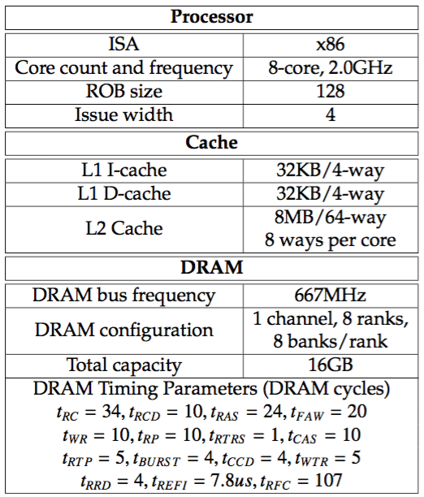
Performance Evaluation
ZSim + DRAMSim2
  ZSim: cores, caches
  DRAMSim2: DRAM
8-program workloads
  24 SPEC CPU2006 benchmarks
  Each program fast-forwards for 1 billion instructions and then simulates for 100 million instructions

Slide 25
SecMC-NI: Effect of Address Randomization
Address randomization benefits hmmer significantly
  Requests are distributed more evenly across banks and ranks

Slide 26
Parameter Sweep for b and d (No Limit)
Smaller b and d result
in better performance
b = 3
b = 6
Smaller b and d result
in more violations

Slide 27
Optimization: Avoiding Worst-Case Times
Gradually increase the value of d with the number of violations
Before Optimization
After Optimization

Slide 28
Parameter Sweep for b and d (no limit)
b = 3
b = 6

Slide 29
Performance under Different Limits
b = 6, d = 160
As the limit gets lower
  Performance starts to decrease due to entering worst-case mode
  Leakage decreases exponentially
Tradeoff between performance and security

Slide 30
Dynamic Tuning of d Value
Static
Initial d value = 160

Slide 31
Comparison with Previous Schemes
SecMC-Bound parameters
  b = 6, d = 160

Slide 32
Combining SecMC-Bound with Partitioning
b = 3
d = 24
Combining SecMC-Bound with spatial partitioning outperforms applying spatial partitioning alone

