Slide 1


ReBudget: trading off efficiency vs. fairness in market-based multicore resource allocation
Xiaodong Wang
José F. Martínez
Computer Systems Lab
Cornell University
Notes:
Feb. 9, 13:30-14:45

Slide 3
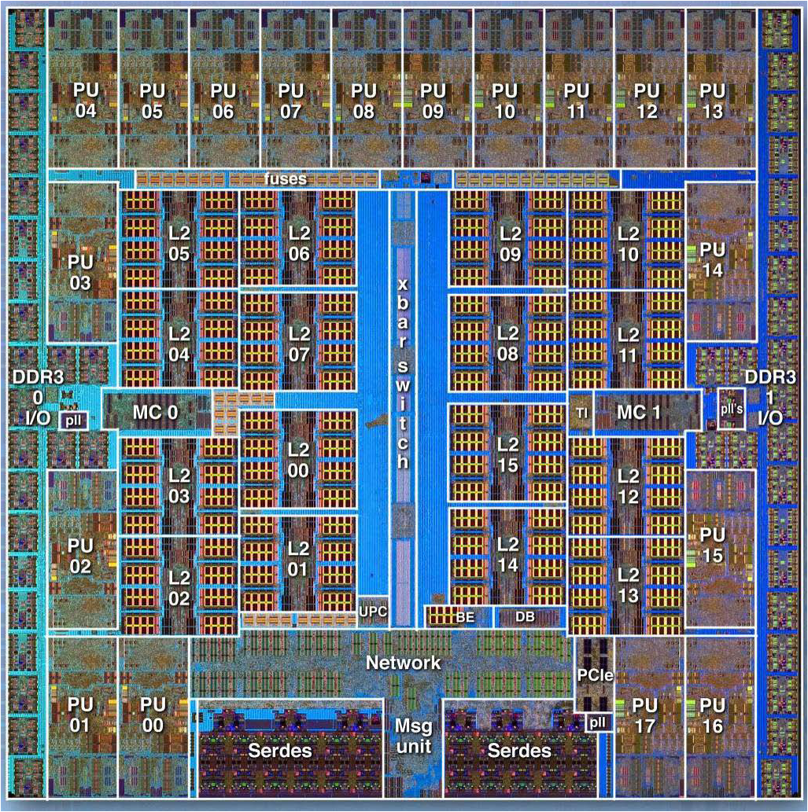
Shared On-chip resources
IBM Blue Gene/Q
Shared
power budget
Shared cache
Shared
memory pins
Shared
interconnect
Source: IBM
Notes:
Designing chip multiprocessors (CMPs) that scale to more than tens or hundreds of cores is an important goal for the upcoming technology generations.
A challenge to scalability is the fact that these cores will inevitably share hardware resources, whether it be the chip’s power budget, last-level cache, off-chip memory bandwidth, shared processing elements, etc.
Allowing cores to freely contend for shared resources is historically been proven to affect the system performance negatively. Therefore, allocating resources intelligently among cores is key to achieving good behavior.

Slide 4
Coordinated resource allocation
Global allocation space very large
  Exponential increase with no. of cores, no. of resources, granularity of resources
  Global hill-climbing unlikely to scale gracefully
(*) art and twolf share 16
cache ways and 20W
power: ~600 points
Notes:
In the past a few years, researchers have found that coordinated resource allocation can greatly improve system performance compared against unmanaged and uncoordinated resource allocation.
Let’s take a look at a simple example – a resource allocation problem in a 2-core CMP. These two cores are sharing two on-chip resources, …, with each core running one SPEC benchmark. This graph shows the system throughput, i.e., the weighted speedup, of all possible resource allocation combinations. As we can see, such allocation space is not trivial.
Uncoordinated resource allocation generally doesn’t search the space effectively, and the resulting allocation are often far from optimal.
However, evaluating all possible allocation combinations are prohibitive, because even in this simple problem, we’re having 600 allocation points, and this number ….

Slide 5
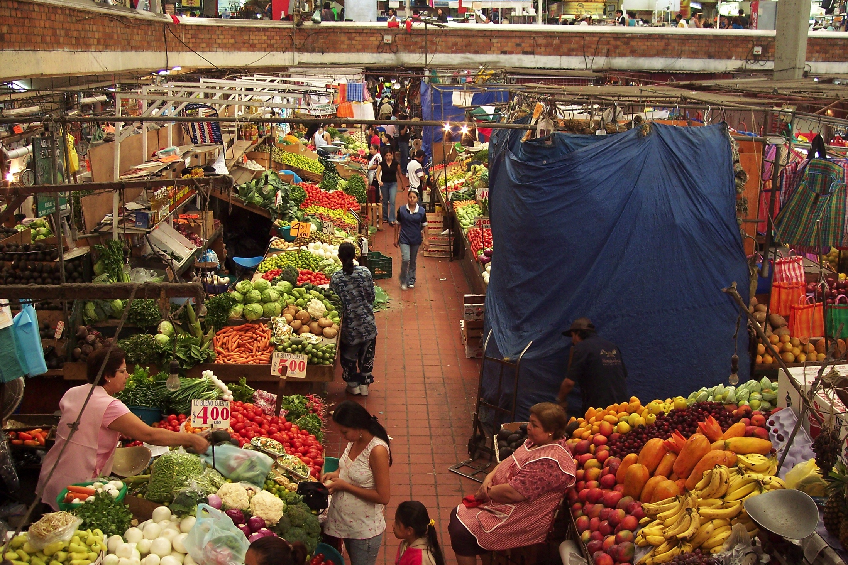
Cue from real-life: Markets
Trade off global optimality with simplicity
  Global optimum very expensive
  Market: Relatively simple, distributed mechanism
    (1) reasonably good; (2) potential for scalability
Source: Wikipedia
Notes:
Facing all these challenges, we’re inspired by a real life problem: traffic regulations. Thousands of cars, multiple routes …..
What people does is to set up a general framework: build the road, set up toll both, traffic signs, etc.
This type of problems with distributed solution exists, can be abstracted as a market, where given a set of general market constraints, players operates to pursue their own benefit, and the market will end up an outcome that everyone is reasonably happy.

Slide 6
XChange (Wang & Martínez, HPCA 2015)
Effective market-based approach
Market players (cores)
  Endowed w/ finite budgets to purchase resources
  Goal: Maximize own utility—regardless of others
  Naturally concurrent
Market maker
  Reconciles bids, posts new prices based on the supply
  Very fast and simple
Converge to market equilibrium dynamically
  High performance: 21% average gain in throughput
  Scalability: < 0.5% overhead for up to 128 cores
Notes:
We propose to treat the CMP resource allocation problem
(rest same as before)

Slide 7
Dynamic price discovery
Market side
  Prices are set in proportional to players’ bids
Player side (cores)
  Model utility—resource relationship
  Bid optimally within its budget constraint to maximize its utility
Set initial
resource prices
Players bid
independently
New prices
computed
Resources
allocated
converge
Prices not
converge
Notes:
Don't say "we propose dynamic..", ---> propose to use dynamic

Slide 8
Wealth redistribution
Budget assignment depends on the definition of optimality
  Fairness-oriented: Give same budget to everyone (XChange-EqualBudget)
  Performance-oriented: Assigning budgets in proportional to the performance gap between minimum and maximum allocation (XChange-Balanced)
Notes:
So far, we only talk about each market player has a finite amount of budget to purchase resources, but how exactly the budget assigned to each individual? The answer is, it depends on the definition of system optimality. A straight forward approach is to give the same budget to everyone. In this way, each player will have the same purchasing power in the market, leading to a fair system. However, we find that this may not be efficient in terms of system throughput.
By utilizing the player model already described, we estimate the budget in proportional to the performance difference between minimum and maximum allocation
Fair budget allocation may not be the best option, if maximizing throughput is what we’re after.
When you’re going after the throughput, this may not be the best option.

Slide 9
XChange: Open questions
Optimality of market equilibrium?
  Pareto optimality ≠ Global optimality
  Tragedy of commons
  Performance/fairness bounds?
Performance vs. fairness trade-off?
  XChange suggests budget can function as “knob”
    Equal budget = “fairness-oriented”
    Utility-proportional budget = “performance-oriented”
  Control performance/fairness meaningfully?
Notes:
We propose to treat the CMP resource allocation problem
(rest same as before)

Slide 10
Proposal: ReBudget
Theoretic lower bounds with respect to global optimum
  System efficiency (performance)
  Fairness
Budget assignment mechanism
  Builds on top of XChange
  Control efficiency vs. fairness systematically
  Evaluation: ReBudget >> theoretic bound often

Slide 11
System efficiency (Performance)
Price of Anarchy (PoA)²
  A “superpower” determines the resource allocation that maximize overall efficiency: Eff(OPT)
  PoA measures the cost of distributed market mechanism over global optimum:
  PoA is lower bound: Worst-case system efficiency
    Market at least as good as PoA (alt., can be as bad as PoA)
[2] Papadimitriou, Algorithms, games, and the Internet, STOC 2004.

Slide 12
Price of anarchy
How “tight” can PoA bound be?
  The best-known theoretic bound of efficiency loss for a market under some specific conditions:³ PoA is 75% of global optimum
How close to theoretic limit can XChange be?
  Hypothesis: We can tighten PoA in XChange by adjusting players’ budgets relative to each other
[3] Ramesh Johari and John N Tsitsiklis. Efficiency loss in a network resource allocation game,
Mathematics of Operations Research, 29(3):407–435, 2004.

Slide 13
market-based approach
Market players (cores)
  Have finite budgets B_{i} to purchase resources in the system
  Try to maximize their own utility by bidding resources
Incentive: the ratio of the utility increase to the bid increase
Utility=Utility_{cache} + Utility_{power}
Notes:
We propose to treat the CMP resource allocation problem
(rest same as before)

Slide 14
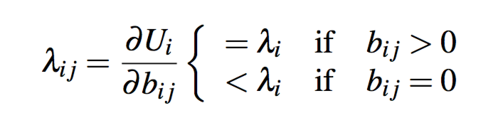
Incentive (a.k.a. Marginal Utility)
Player’s incentive to adjust bids
  Intuition: if a player bids optimally, its “incentive” for different resources are the same
  Otherwise, a revision of its bids can improve its utility
Mathematical representation
  Assume utility functions are smooth and concave*
  Define player i’s marginal utility （incentive) for resource j: , and incentive of player i:
  Lagrange multiplier method:
Notes:
We propose to treat the CMP resource allocation problem
(rest same as before)
Animation here?

Slide 15
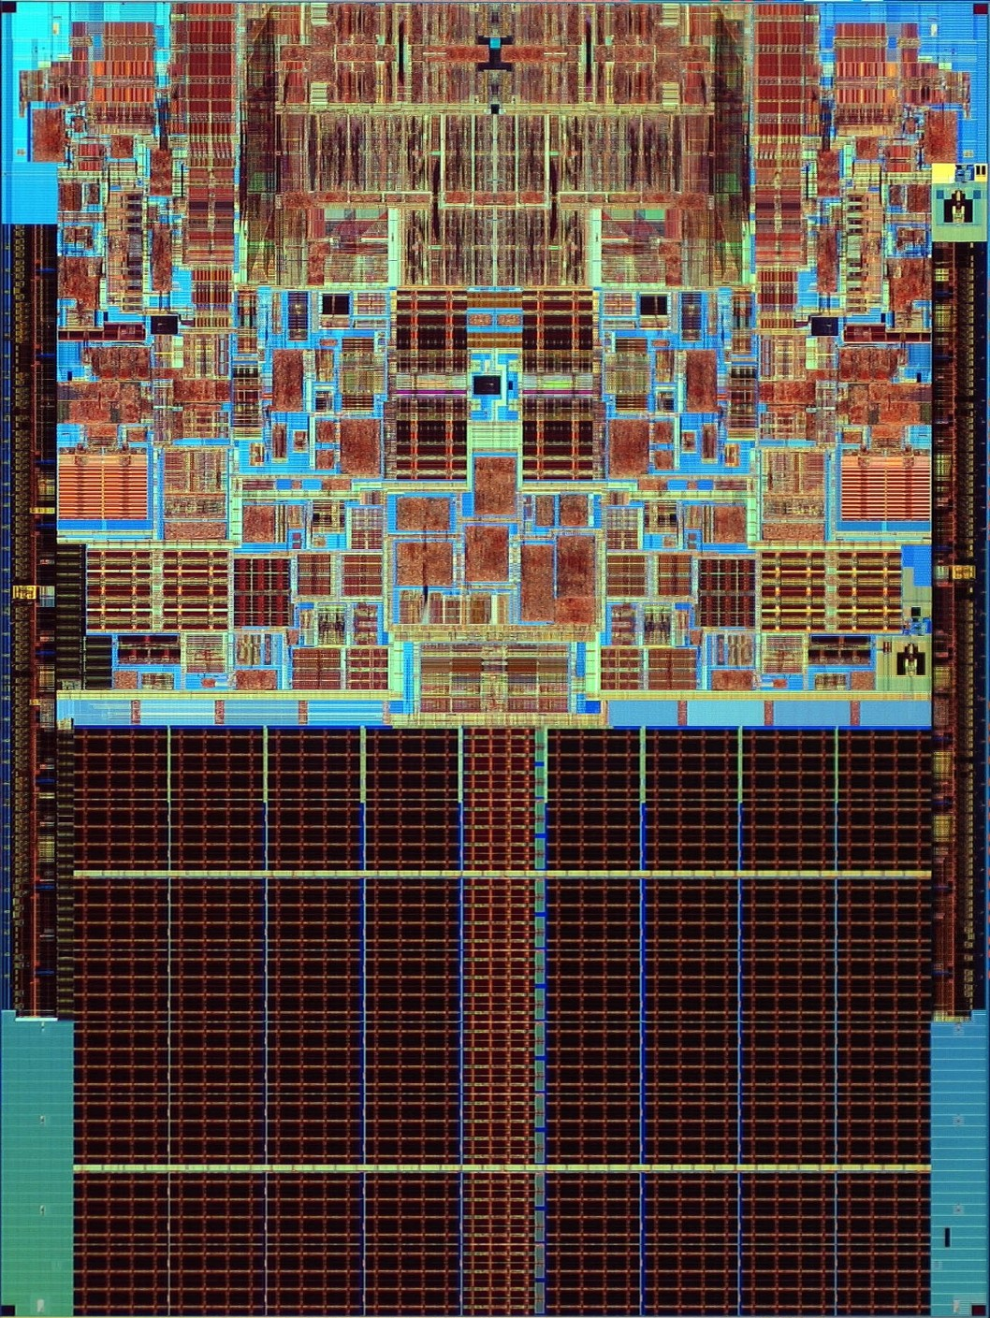
ReBudget: Incentive Across Players
Intuition: at equilibrium, player i’s incentive λ_{i} measures its utility improvement if it is given more money (i.e., assigned a larger budget)
  Consider 2-player market:
Core1
Core2
$100
$100
$101
$99
＋0.04
U₂=65%
U₁=90%
U₂=60%
U₁=89%
λ2=4%
λ1=2%
λ2=5%
λ1=1%
L2 Cache

Slide 16
Price of anarchy
Market utility range (MUR): maximum variation of marginal utility λ_{i} of all market players:
  Introduce this metric into the proof of [3]:
  If ,
  If ,
Proof
[3] Ramesh Johari and John N Tsitsiklis. Efficiency loss in a network resource allocation game,
Mathematics of Operations Research, 29(3):407–435, 2004.

Slide 17
System fairness
System fairness: Envy-freeness
  Envy: how a player prefer others resources:
  Given allocation r = (r₁, r₂, …), envy-freeness is defined:
  C-approximate envy-free:

Slide 18
Fairness: envy-freeness
Players’ budget difference is a natural way to measure fairness in the market
  Equal budget leads to equal purchase power
  Larger budget variation leads to worse fairness
Define Market Budget Range (MBR) as the variation in players’ budget:
Introduce this metric into the proof of [4]:
  The market equilibrium with budget range MBR is -approximate envy-free
[4] Li Zhang. The efficiency and fairness of a fixed budget resource allocation game.
In Automata, Languages and Programming, pages 485–496. Springer, 2005.

Slide 19
ReBudget: trade off efficiency and fairness
Measuring MUR and MBR, we can quantify the loss in efficiency and fairness of market equilibrium
Use MUR and MBR to guide budget re-assignment
  To improve PoA: punish the players whose incentives are low
  Guarantee minimum fairness set by system admin

Slide 20
ReBudget: trade off efficiency and fairness
Given a fairness target
  Compute MBR: ; initialize “penalty”:
  Use XChange to reach market equilibrium
  Player i with incentive lower than 50% of the maximum incentive has to pay a “penalty” (equivalent to a budget cut)
Maximum Budget is X, minimum budget is X•MBR
3. Impose
penalty
Resources
allocated
1. Initialize
2. XChange
converge
“penalty” is halved
Notes:
Why to decrease budget? Decrease the budget for player with low \lambda_i, less purchase power, higher \lambda_i

Slide 21
Other issues
Assumption: a player’s utility function is non-decreasing, continuous, and concave
  Adopt Talus⁴ and Futility Scaling⁵, which convexifies the cache behavior
[4] Beckmann and Sanchez, HPCA, 2015.
[5] Wang and Chen, MICRO 2014

Slide 22
Experimental setup
Simulation setup
  4 GHz 4-way OoO core, 32 kB i/d L1
  8- and 64-core CMP
  4MB (16 way) and 32MB (32 way) L2 Cache
  10W per core as equal-share
  DDR3-1600 channels, 4 ranks ea., 8 banks/rank
Performance analysis
  Mix of SPEC2000 and SPEC2006 multi-programed workloads
Notes:
Partition L2 cache based on cache ways. Essentially, other cache allocation techniques, such as z-cache, vantage essentially mimic high associativity with limited physical cache ways. There is no fundamental reason that we cannot use it.
not really a limitation: essentially z-cache does the same thing
640W thing: IBM Power8 12 core: 200-250W @ 22nm
Intel Haswell: 155W@ 22nm
The results doesn’t depend on the absolute number.
The actual cache partition is orthogonal to our proposal.

Slide 23
Evaluation
Analytical experiment
  Profile 24 SPEC 2000 and SPEC 2006 applications
  Assume cache and power behavior are perfectly continuous and concave
  Create 240 bundles that fall into six categories: CPBN, CCPP, CPBB, BBNN, BBPN, and BBCN
Implement ReBudget in simulator
  Utility function is modeled in the run-time
  ReBudget is triggered every 1ms to adapt to application phase changes

Slide 24
Efficiency
XChange ,
Wang and Martínez,
HPCA 2015

Slide 25
Fairness
ReBudget-mild
ReBudget-aggressive

Slide 26
Simulation results: efficiency

Slide 27
Simulation results: fairness

Slide 28
SUMMARY
Heuristic-based market-based approach can suffer low efficiency: tragedy of commons
We provide theoretic guarantees on system efficiency and fairness for arbitrary budget assignment
  Introduce two metrics: market utility range (MUR) and market budget range (MBR) to quantify the loss of system throughput and fairness
ReBudget efficiently trade off system efficiency and fairness
  ReBudget-aggressive achieves 95% efficiency for all application bundles

Slide 29
ReBudget: trading off efficiency vs. fairness in market-based multicore resource allocation
Xiaodong Wang
José F. Martínez
Computer Systems Lab
Cornell University
Notes:
Feb. 9, 13:30-14:45

Slide 30
Backup slides

